Slide 1
ANALYSIS ON INTERNATIONAL FOOTBALL RESULTS
MSc Computer Science
(Specialization in Soft Computing)
2019-2021
Semester 1 - Mini Project

Slide 2
TEAM GUIDE AND MEMBERS
Ms. Jiby TC (Project guide)
Edwin U Kannanaikkal (32319011)
Naheela PK (32319016)
Sathyajith KP (32319024)

Slide 3
DATA VISUALIZATION
“Data visualization converts information into visuals”
Data visualization provides an important suite of tools for gaining a qualitative understanding and quantitative descriptions on data set with the help of graphs, plots and charts
Important skill in applied statistics and machine learning

Slide 4
Analysis on International Football results :
Our project was inspired by the Kaggle.com “International Football Results from 1872 to 2019” dataset.
From International football results we can predict the game trend of 1872 to 2019
Between these years there are 40,000+ matches have been played between countries in championships and friendly matches.

Slide 5
Dataset Description
This dataset includes 41,540 results of international football matches from 1872 up to 2019. Dataset includes the following columns:
date - date of the match
home_team - the name of the home team
away_team - the name of the away team
home_score - full-time home team score
away_score - full-time away team score
tournament - the name of the tournament
city - name of the city where the match was played
country - name of the country where the match was played
neutral - TRUE/FALSE whether the match was played at a neutral venue

Slide 6
Aim :
In our project we visualized this data set for obtaining the following conclusions:
Number of matches played in each year.
Best 10 teams of all time
Which teams dominated different periods of football:
(1870-1920, 1920-1970, 1970-2020)
What trends have there been in international football throughout the ages (home advantage)
home_score Vs away_score

Slide 7
Literature Review
‘International Football Results from 1872 to 2019’ is a quite large data set that is on its 4th version by Mart Jurisoo
There are more than 60 kernels available that are contributed by various people
Among these kernels the most studied topics are:
Prediction of world cup winner
Rivalries through pivot tables
Euro 2020 qualifier predictions
Trend changing over the years in International football

Slide 8
LIBRARIES USED
pandas
numpy
matplotlib
seaborn

Slide 9
System Requirement:
Environmental Requirements:
1. Tool : Jupyter notebook , Anaconda
2. Language : Python
3. Operating System : Windows 7 or above/Linux
Hardware requirement :
1. Processor : Intel core i3
2.RAM : 4GB
3.Hard disk : 500 GB

Slide 10
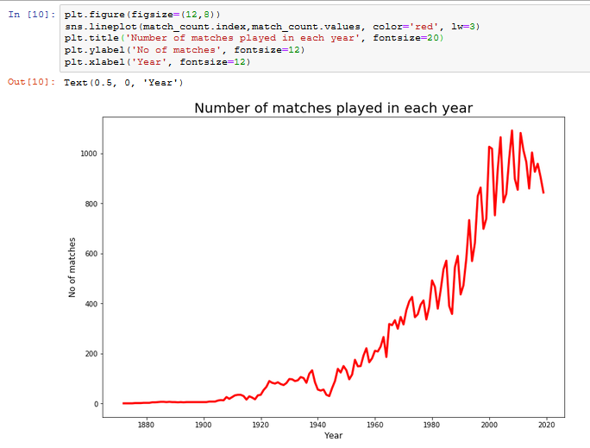
1. Number of matches played in each year (Line Plot)
Design And Implementation

Slide 11
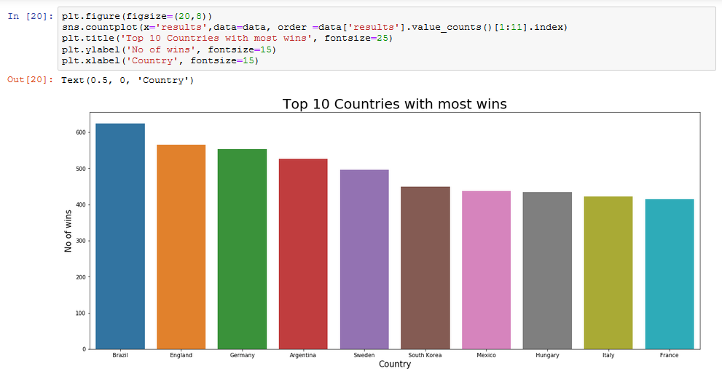
2. Best 10 teams of all time.

Slide 12
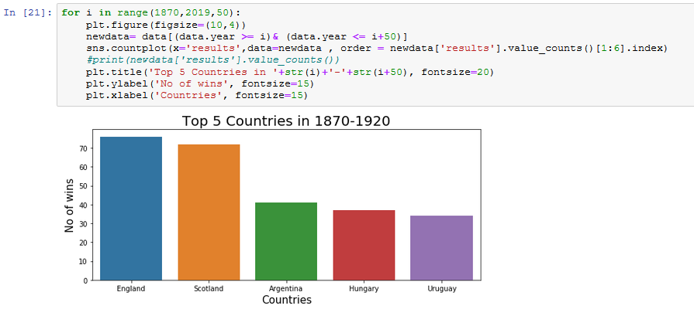
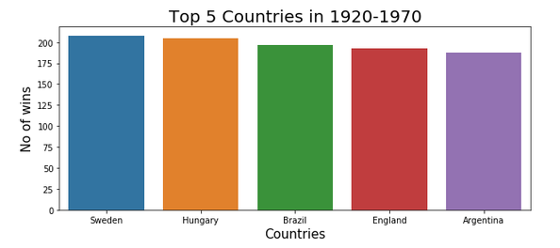
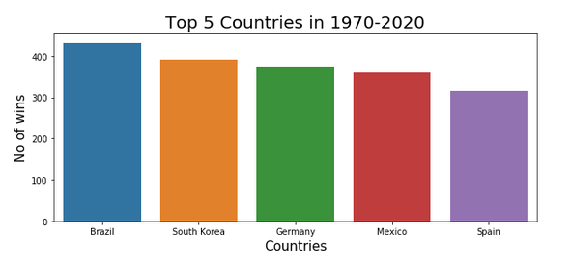
3.Which teams dominated different periods of football: (Count Plot)

Slide 13
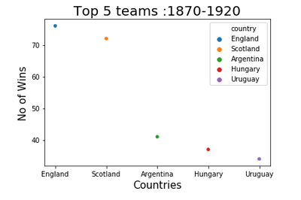
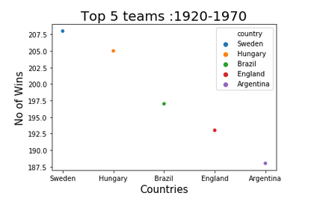
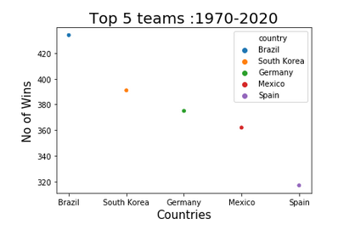
3.Which teams dominated different periods of football: (Swarm Plot)

Slide 14
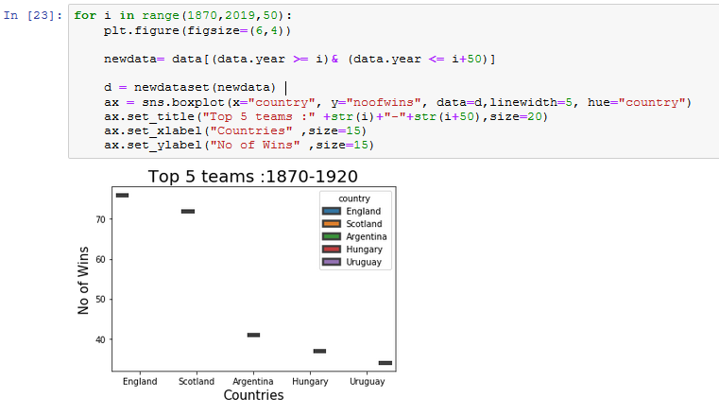
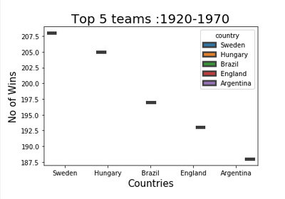
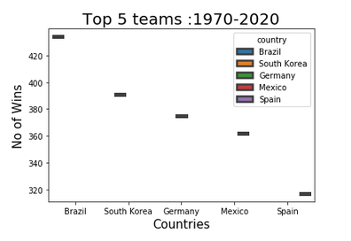
3.Which teams dominated different periods of football: (Box Plot)

Slide 15
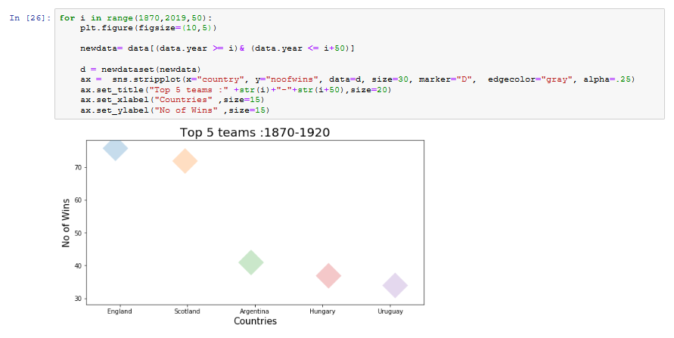
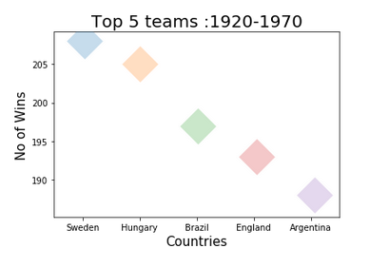
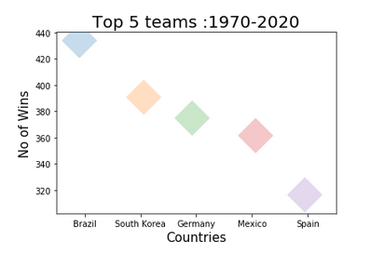
3.Which teams dominated different periods of football: (Strip Plot)

Slide 16
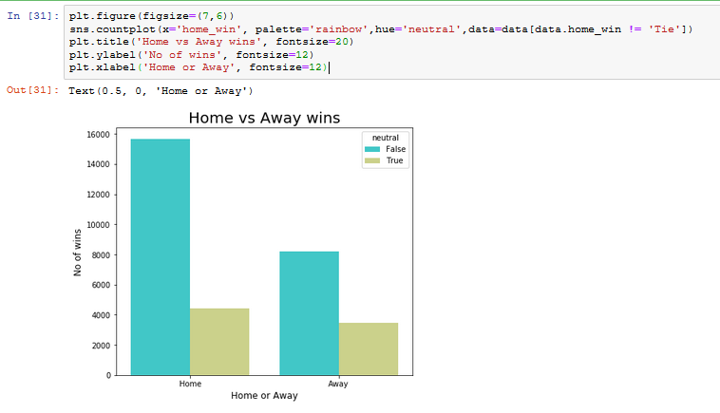
4.What trends have there been in international football throughout the ages (home advantage)

Slide 17
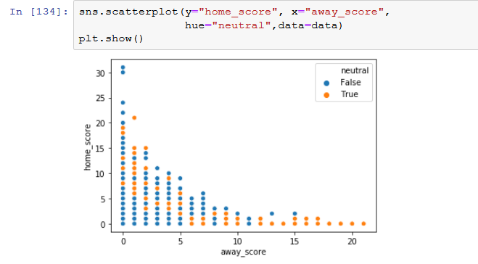
5.Homescore Vs Away score (Scatter plot)

Slide 18
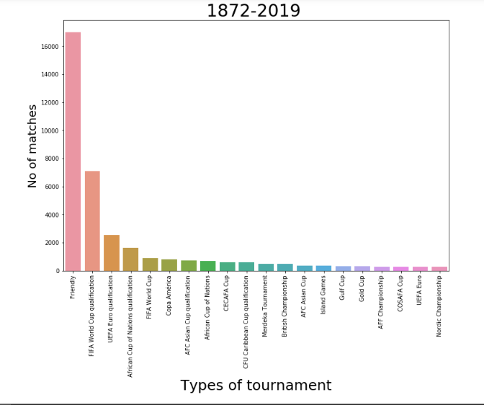
6. Types of tournament and number of matches

Slide 19
CONCLUSION

Slide 20


